Slide 1
Super Store Sales Financial Analysis Dashboard
Name: ABIRAMI
College: ST.JOSEPH’S COLLEGE FOR WOMEN TIRUPUR
Department: B.Sc.Cs With DATA ANALYTICS
Project: Super Store Sales Data
Date: 05/06/2025

Slide 2
Dashboard Overview
Objective :
Provide a comprehensive overview of sales performance for the Super Store.
Enable data-driven decision-making through interactive visuals.
Key Features :
Interactive charts and graphs.
Filters/slicers for dynamic analysis.
Clear representation of sales trends and patterns.
Line charts, funnel charts, pie charts are used

Slide 3
Segment-Wise Sales Analysis
Insights :
The dashboard shows sales performance across three customer segments: Consumer, Corporate, and Home Office.
Key Data :
Consumer : $1.16M (50.56%)
Corporate : $0.71M (30.74%)
Home Office : $0.43M (18.7%)
Takeaway : The Consumer segment contributes the most to total sales.
Visual : Pie chart showing "Sum of Sales by Segment."

Slide 4
Sub-Category and State-wise Sales
Sub-Category Sales :Top-performing sub-categories:
Phones: $223.84K
Chairs: $203.41K
Storage: $167.38K
Low-performing sub-categories:
Fasteners: $0.9K
Art: $3.02K
Insights :
The dashboard shows sales performance across three customer segments: Consumer, Corporate, and Home Office.
Key Data :
Consumer : $1.16M (50.56%)
Corporate : $0.71M (30.74%)
Home Office : $0.43M (18.7%)
Takeaway : The Consumer segment contributes the most to total sales.
Visual :
Pie chart showing "Sum of Sales by Segment.

Slide 5
Segment-Wise Sales Analysis
Insights :
The dashboard shows sales performance across three customer segments: Consumer, Corporate, and Home Office.
Key Data :
Consumer : $1.16M (50.56%)
Corporate : $0.71M (30.74%)
Home Office : $0.43M (18.7%)
Takeaway : The Consumer segment contributes the most to total sales.
Visual :
Pie chart showing "Sum of Sales by Segment.

Slide 6
Segment-Wise Sales Analysis
Insights :
The dashboard shows sales performance across three customer segments: Consumer, Corporate, and Home Office.
Key Data :
Consumer : $1.16M (50.56%)
Corporate : $0.71M (30.74%)
Home Office : $0.43M (18.7%)
Takeaway : The Consumer segment contributes the most to total sales.
Visual :
Pie chart showing "Sum of Sales by Segment.

Slide 7
Regional Sales and Additional Metrics
Regional Sales :
Regions with the highest sales:
West: $725.46K (31.58%)
East: $678.78K (29.55%)
Other regions:
Central: Moderate contribution.
South: Lower contribution.
Takeaway : Focus on West and East regions for expansion.
Additional Metrics :
Discounts : Total discount amount applied.
Quantity : Total units sold.
Profit : Total profit generated.
Takeaway : Balance between discounts and profit margins.

Slide 8
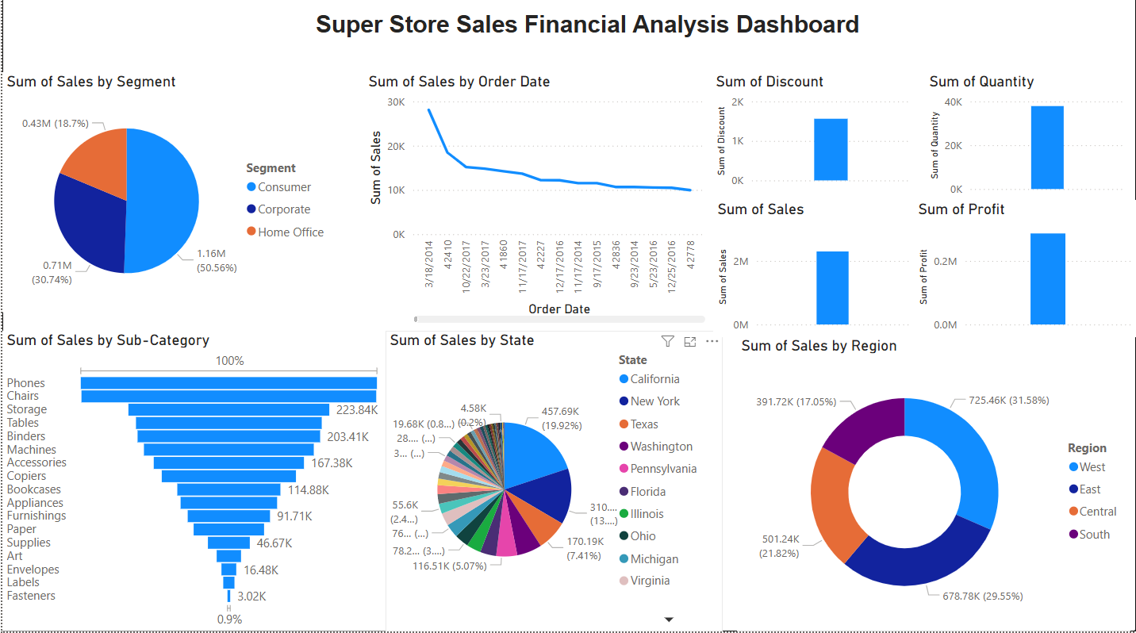

Slide 9


